Slide 1

100% Build Status Update
Michael Bransky, Noah Keyes, Vergil Sorg

Slide 2
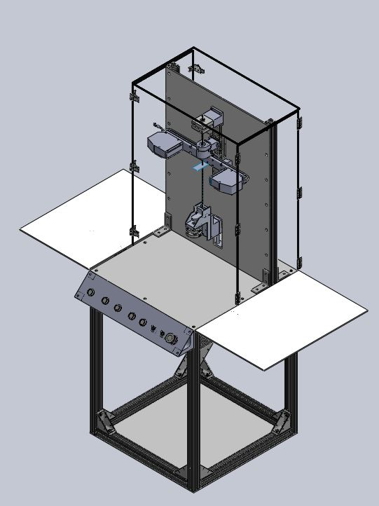
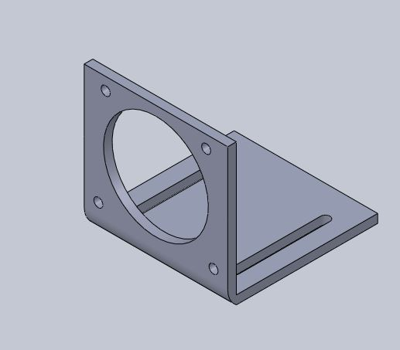
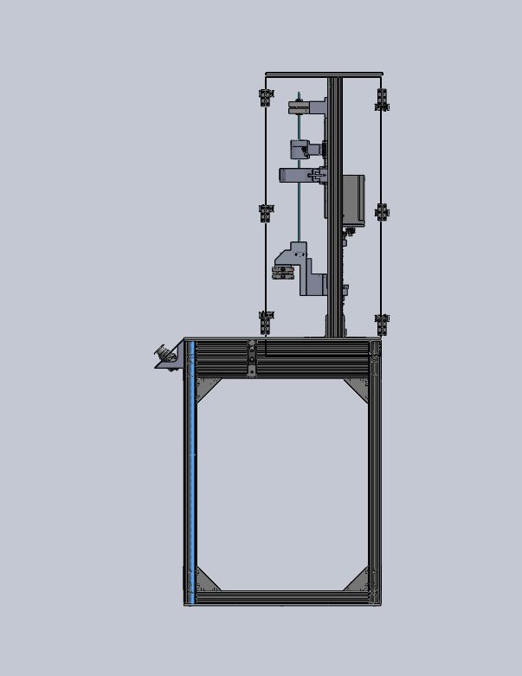
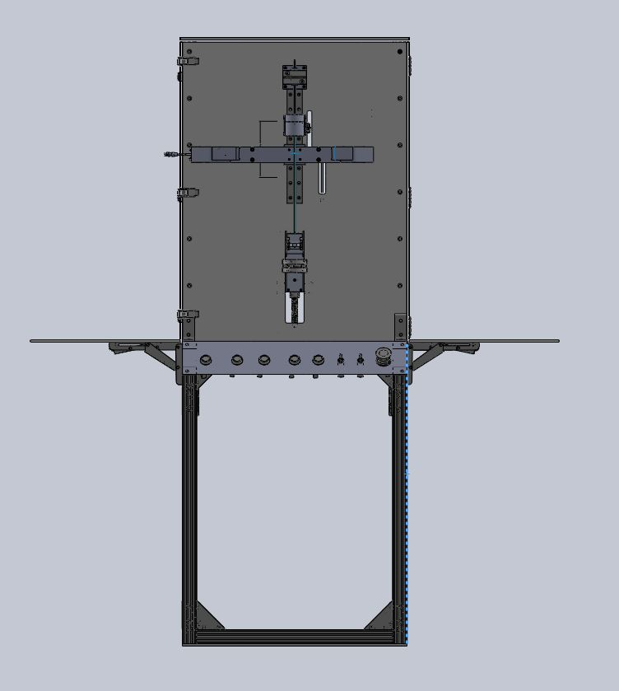
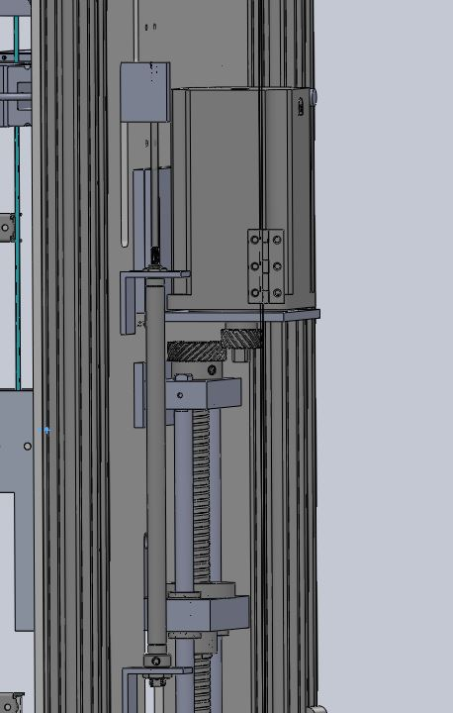
Design Efforts -CAD

Slide 3
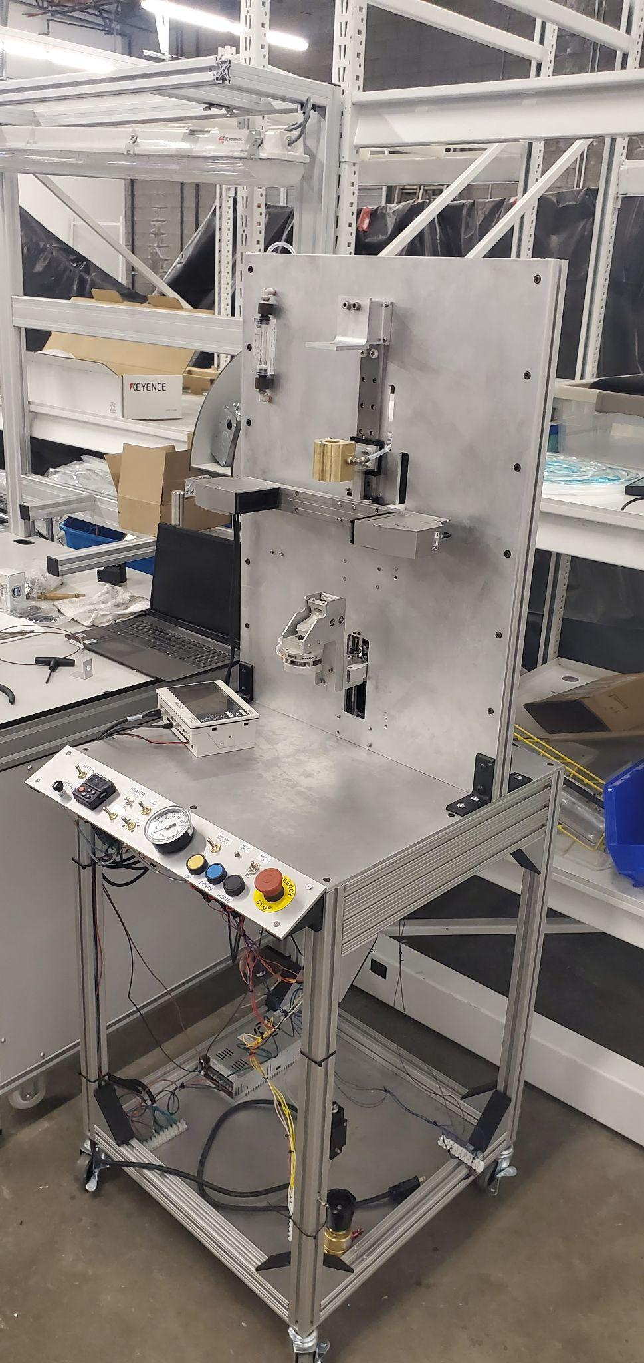
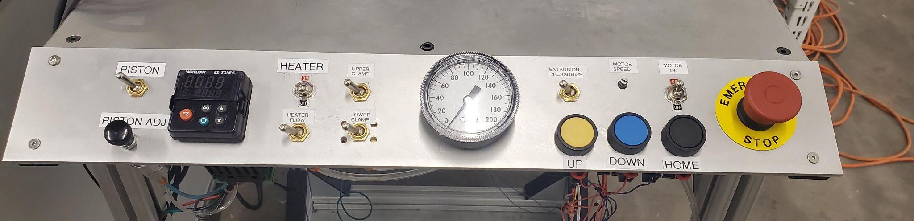
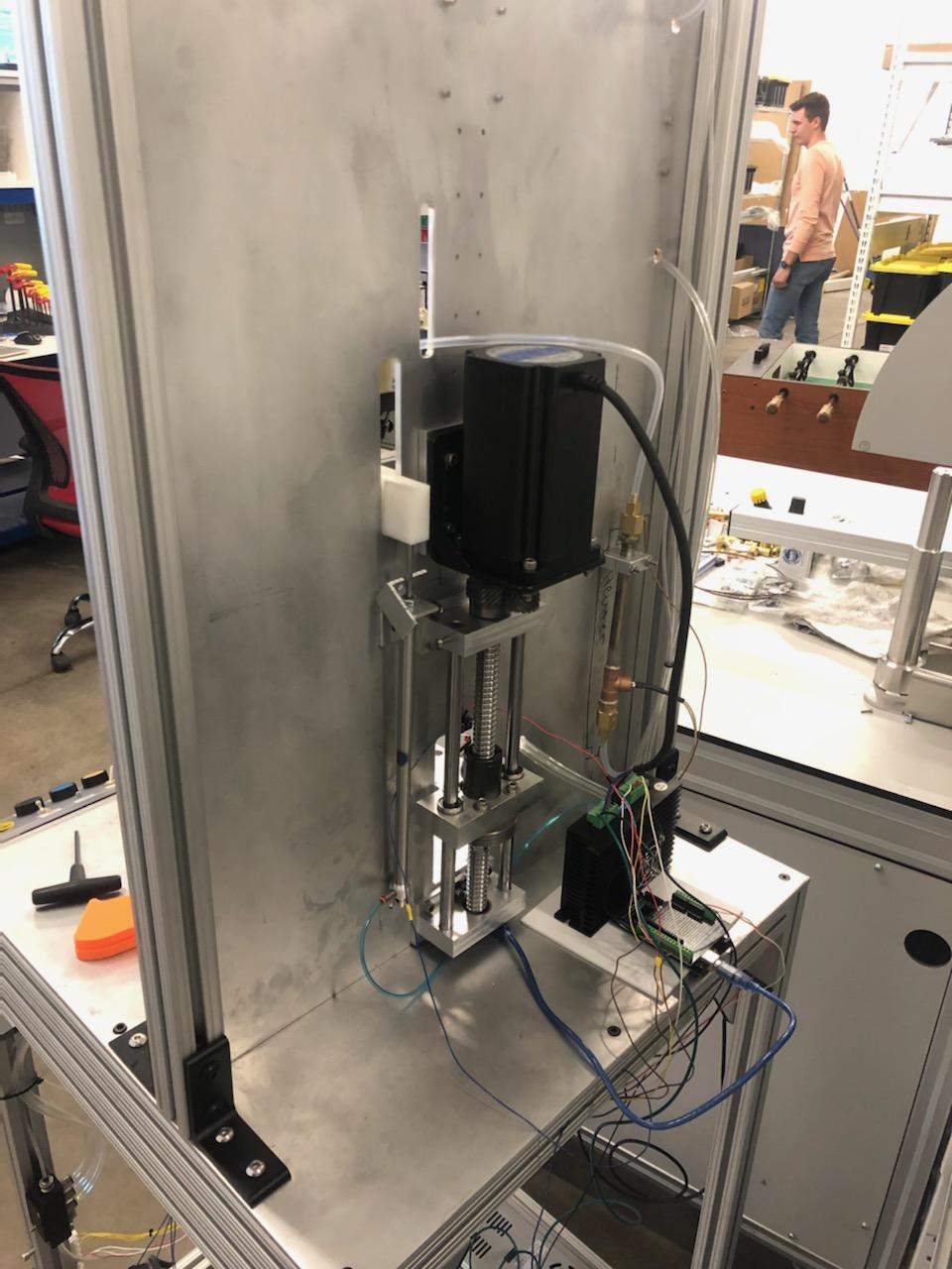
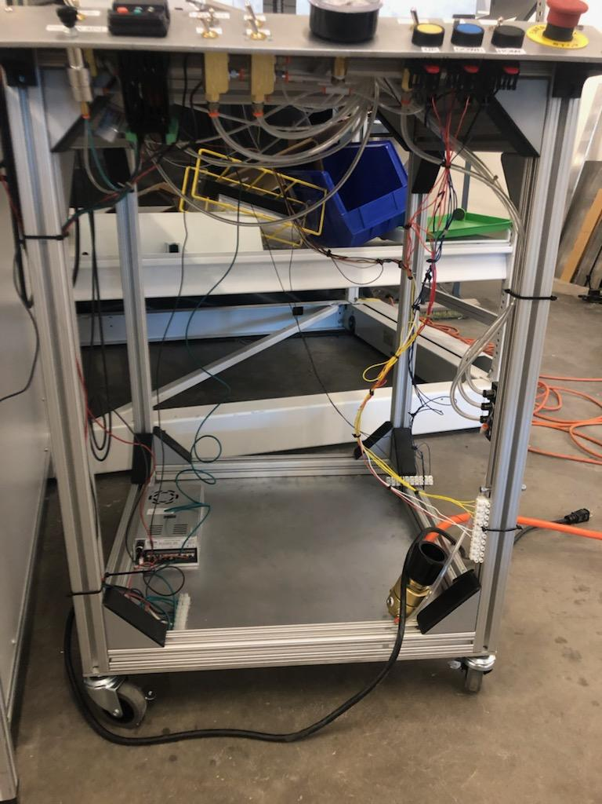
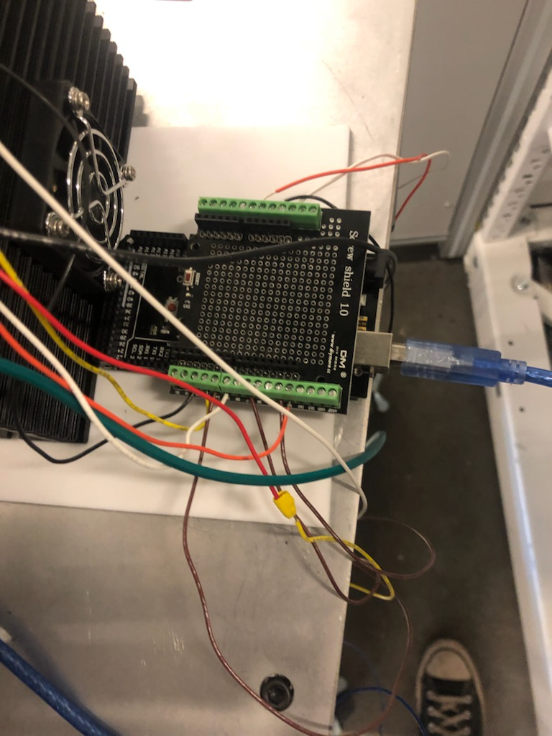
Design Efforts

Slide 4
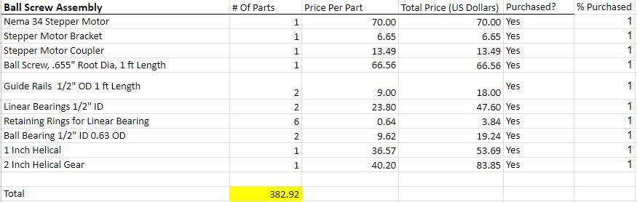
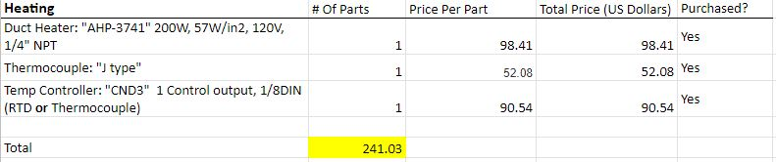

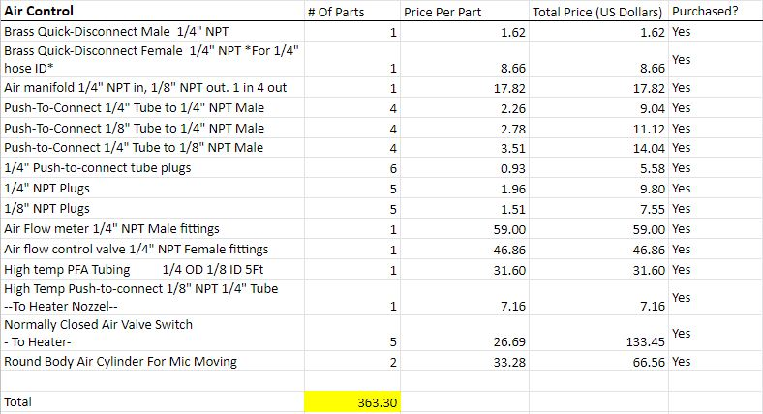
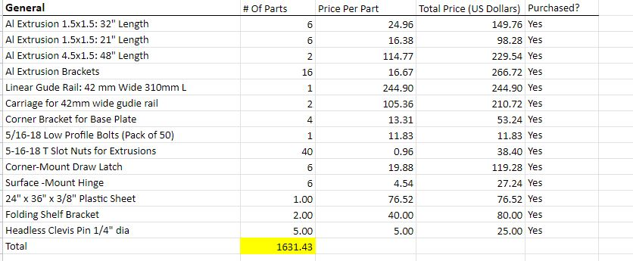

Purchasing Plan

Slide 5
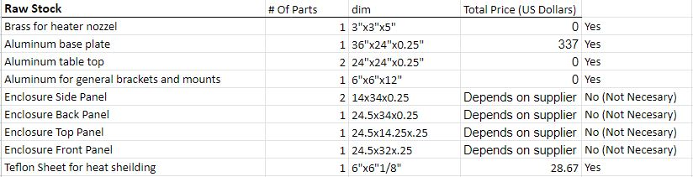
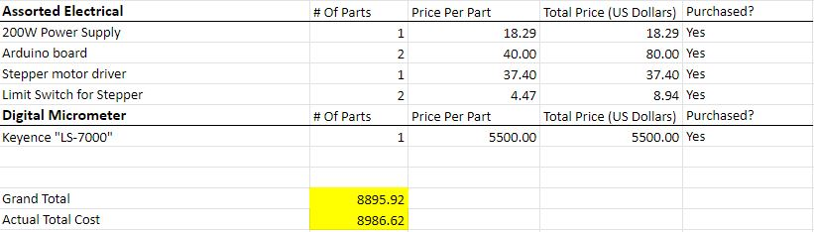
Purchasing Plan

Slide 6
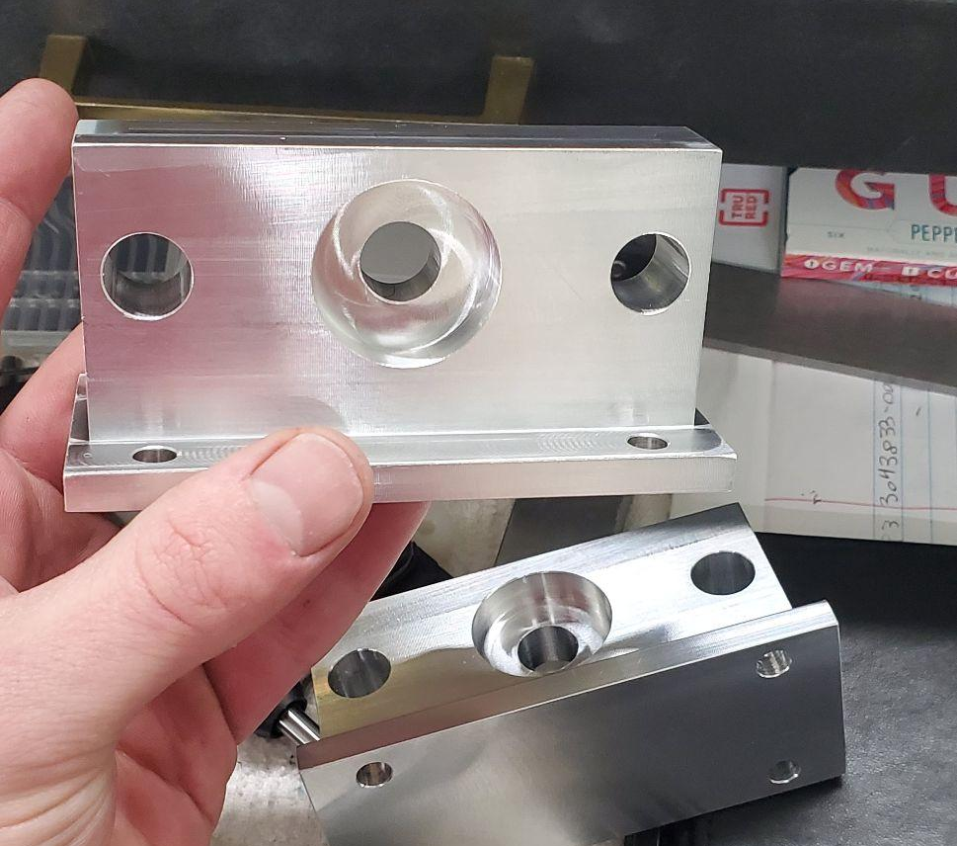
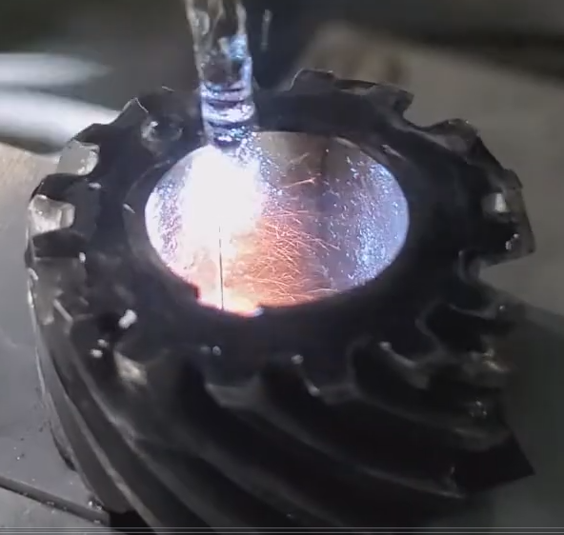
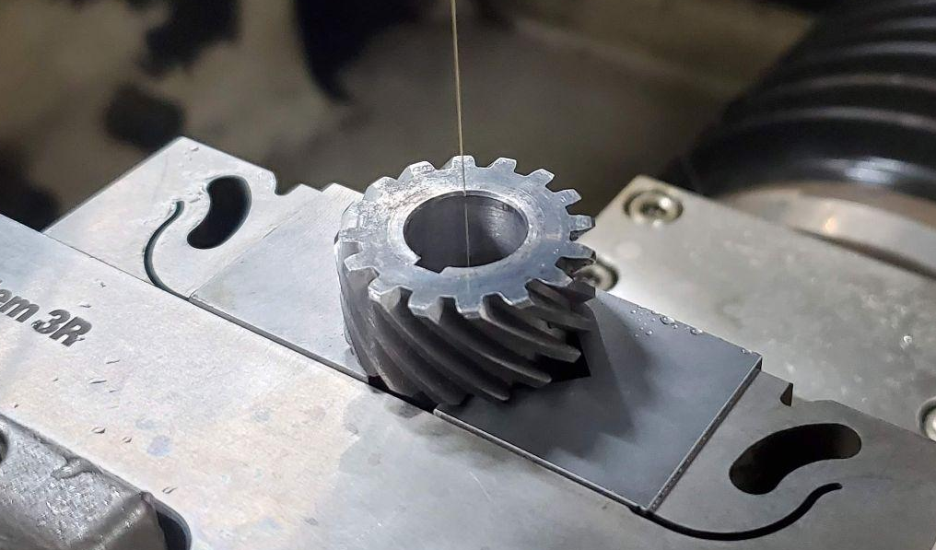
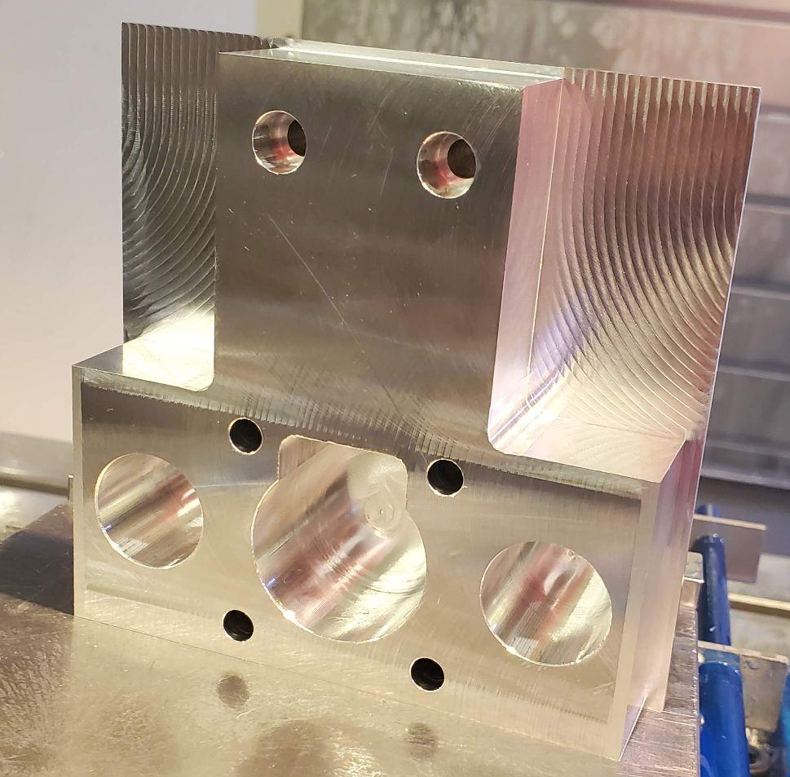
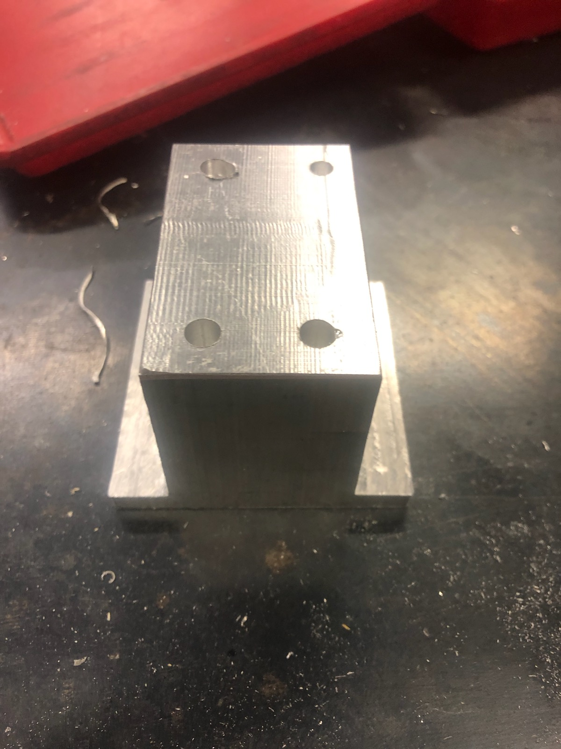
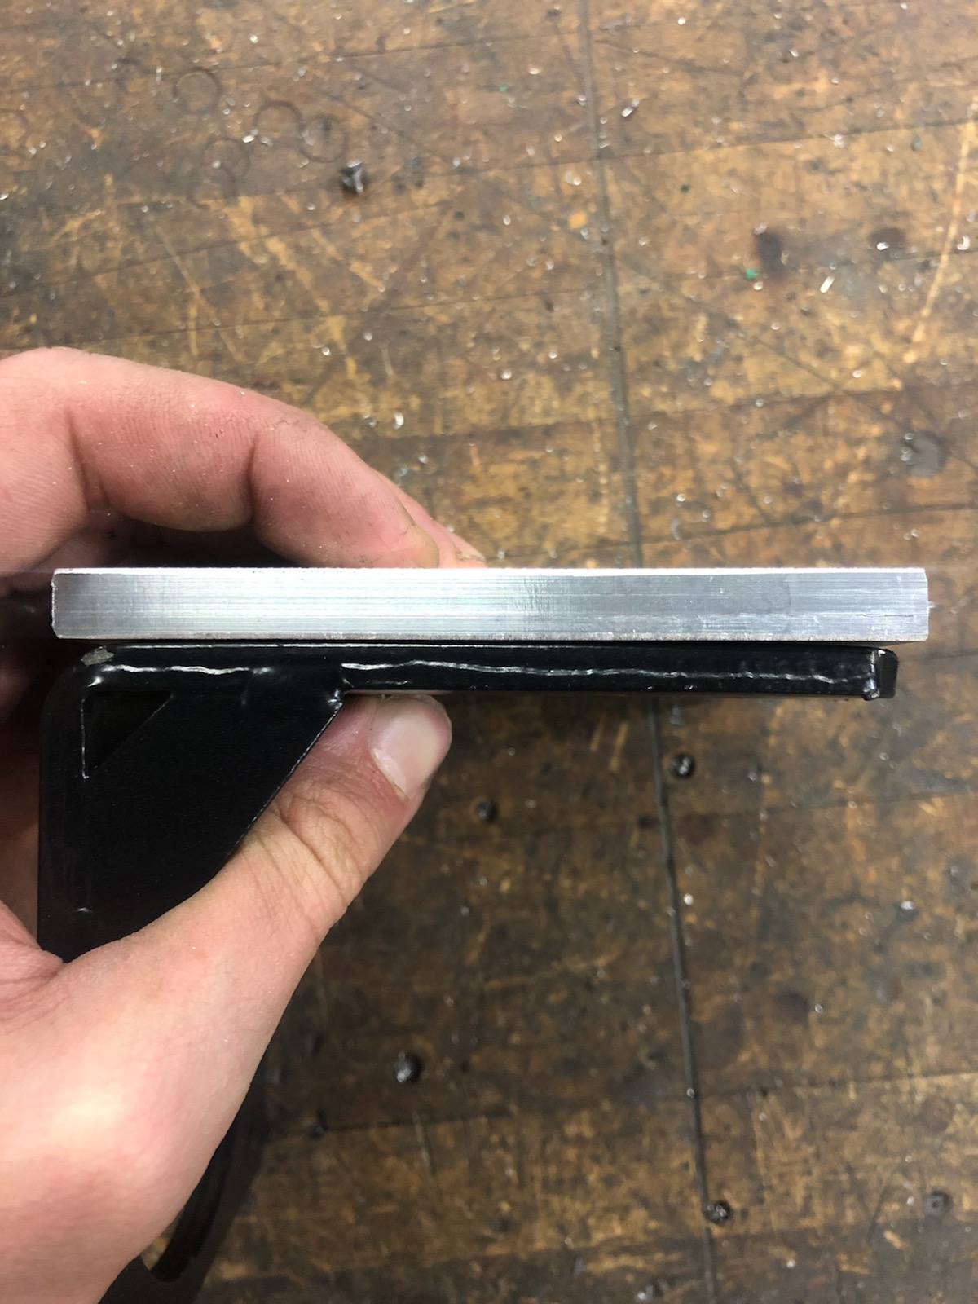
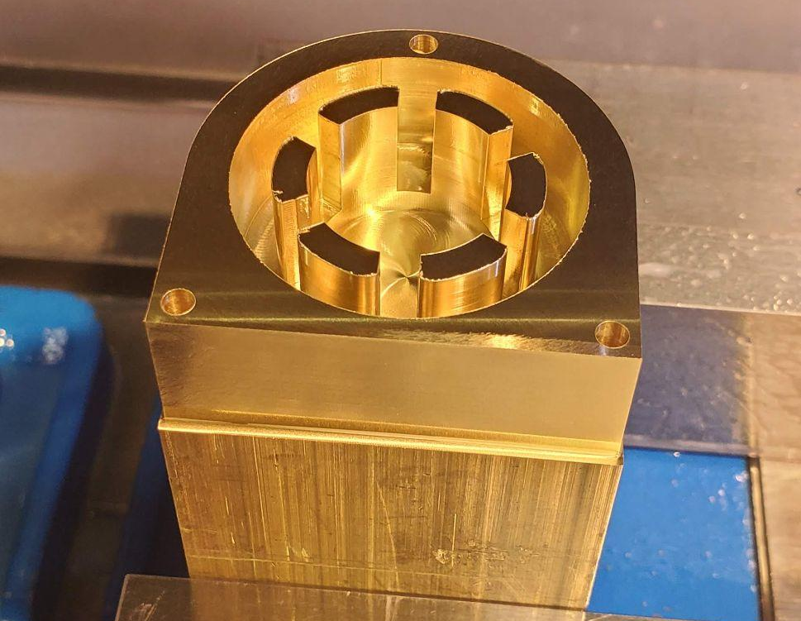
Manufacturing

Slide 7
Manufacturing Update
Parts which have been manufactured.
All base plates (3)
Ball screw mounts (3)
Ball screw guide rails (2)
Heater nozzles (2)
Button panel (ongoing)
Button panel mounts (2)
Pneumatic cylinder mounts (2)
Side tables (2)
Ball screw end modification (1)
Heater mounts (2)
Closed end clamp mounts (1)
Open-end Bimba mount (1)
Button panel mounting brackets (2)
Parts which could be manufactured
Enclosure Panels (Not necessary for machine function, would be done by hand)
Electrical box (3D printed)
Potentiometer Knob (3D printed)
Name Plate!

Slide 8
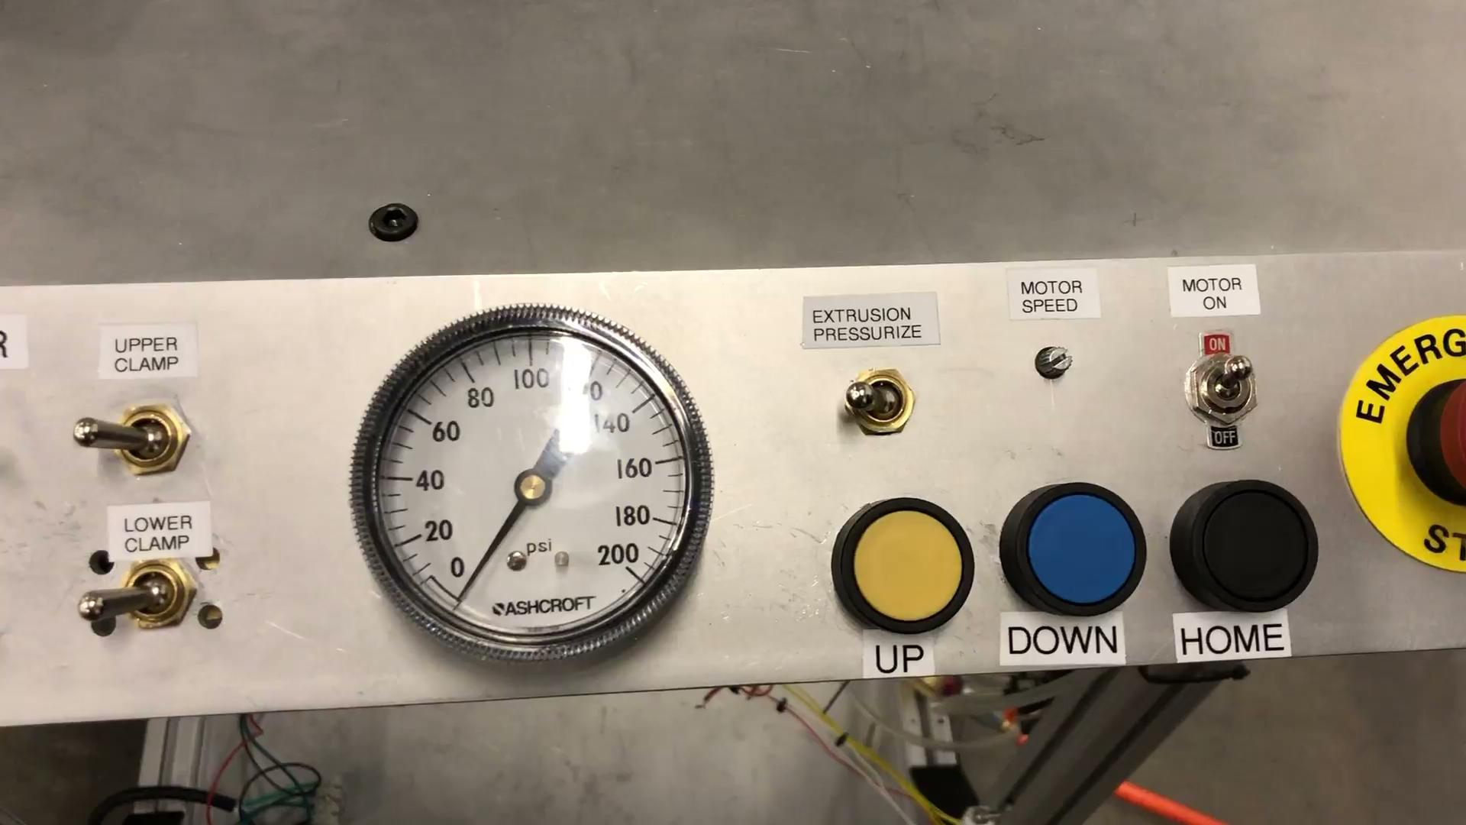
Demonstration - Extrusion Pressurization

Slide 9
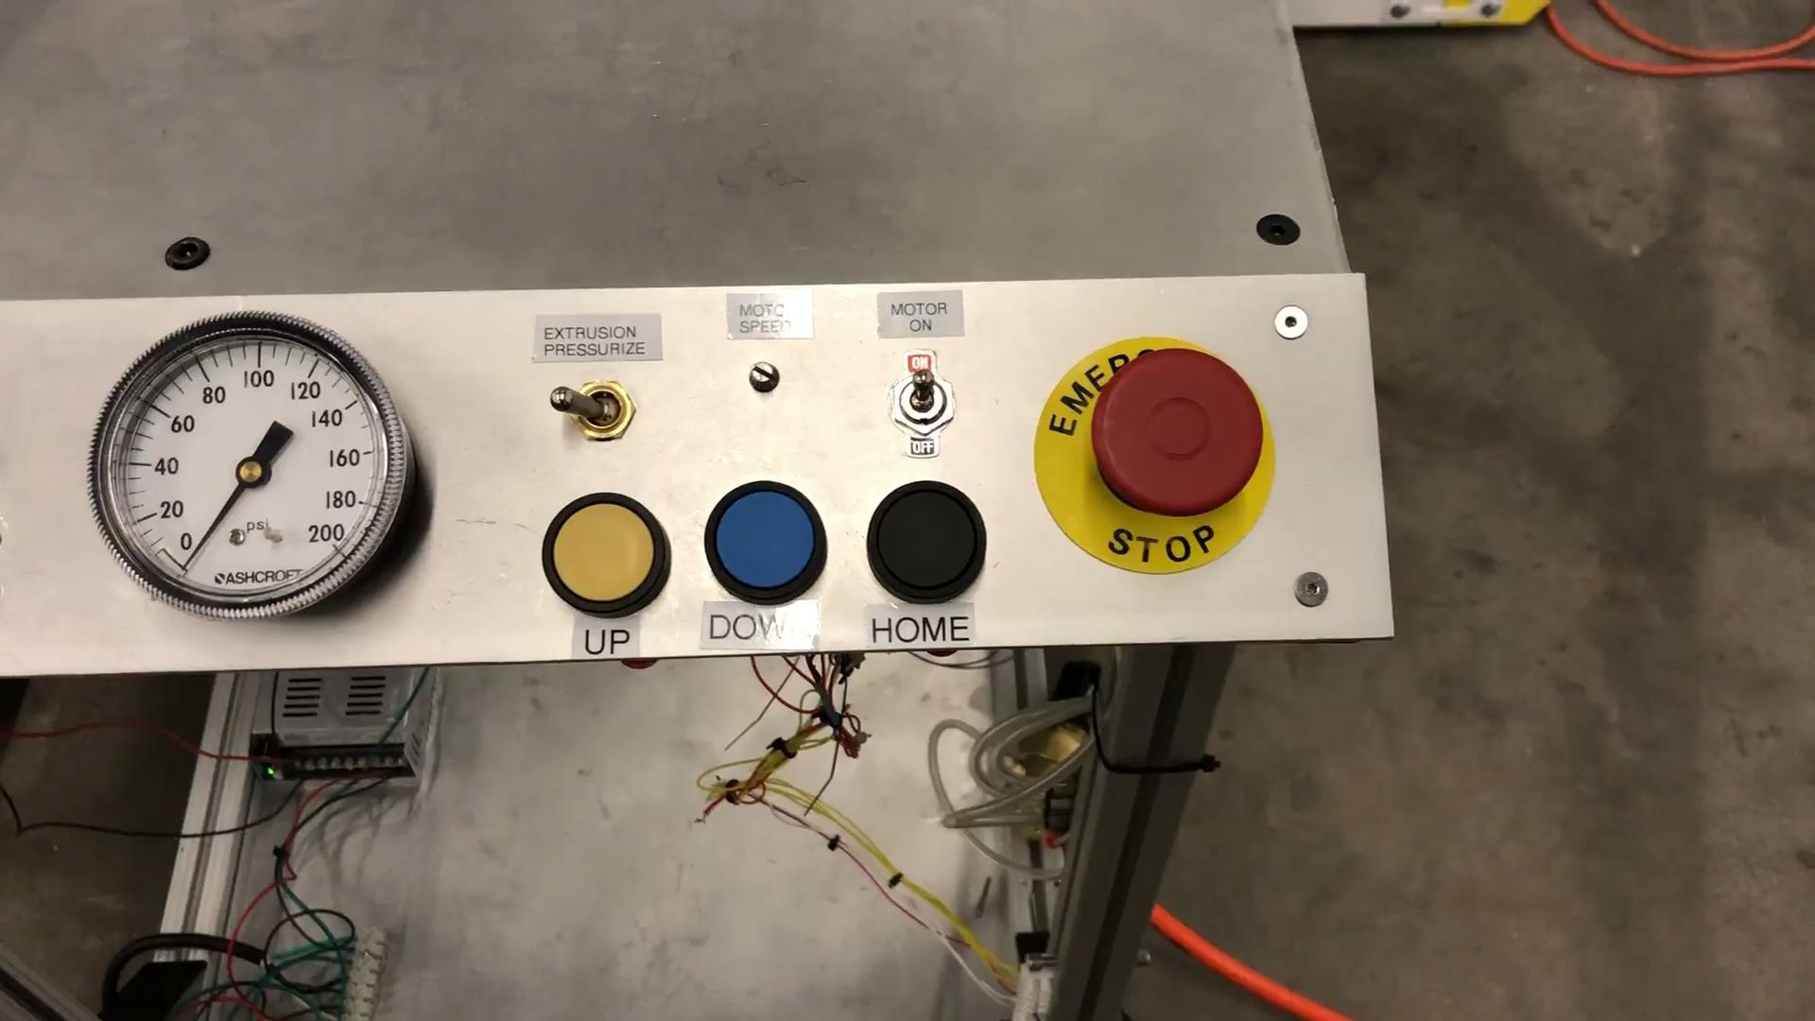
Demonstration - Linear Actuation

Slide 10
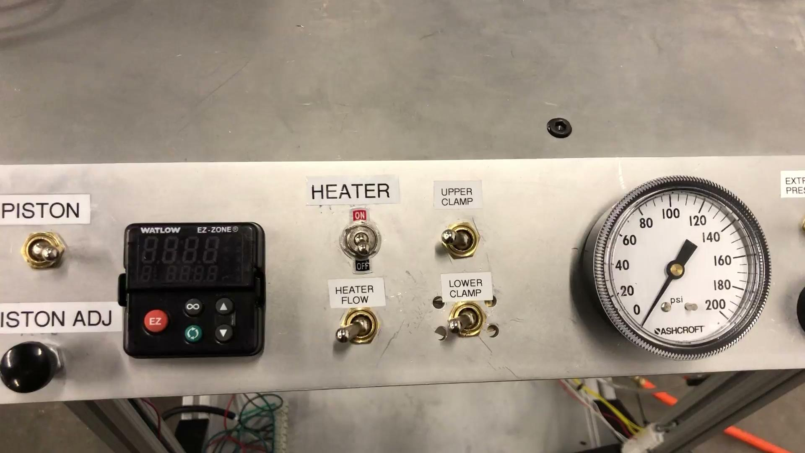
Demonstration - Lower Clamp

Slide 11
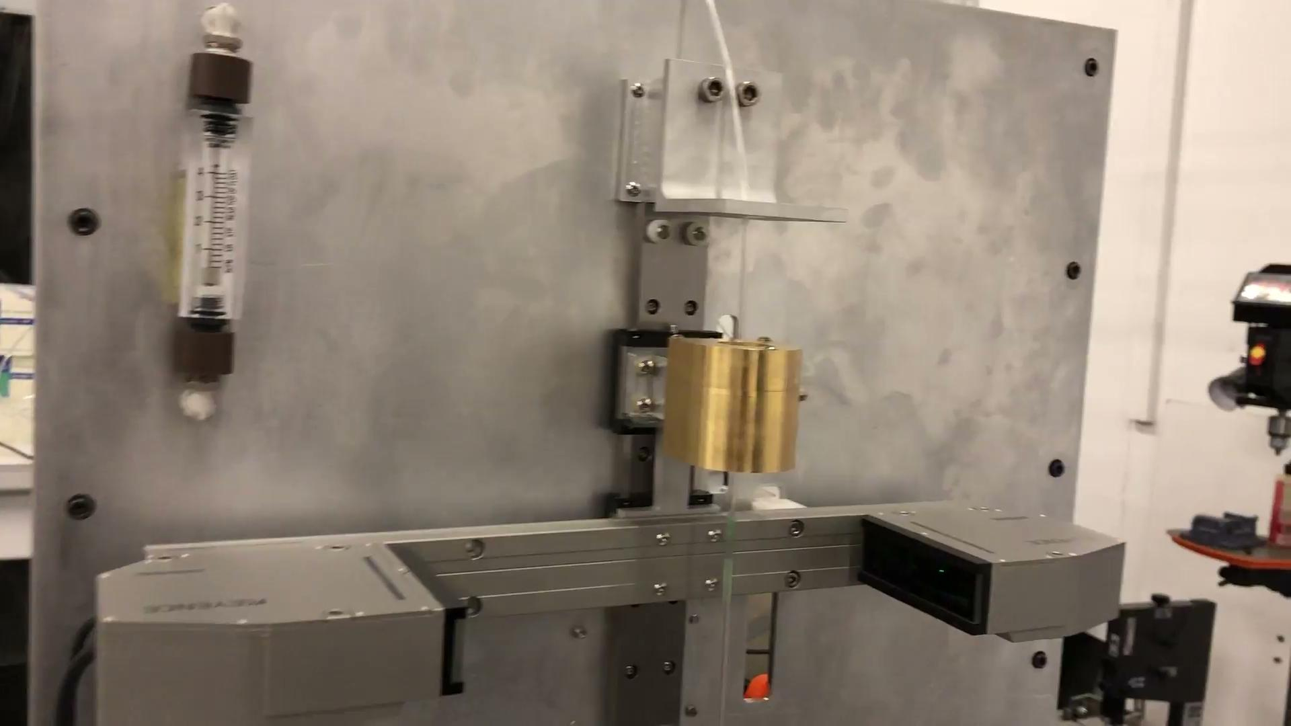
Demonstration - Heating System

Slide 12
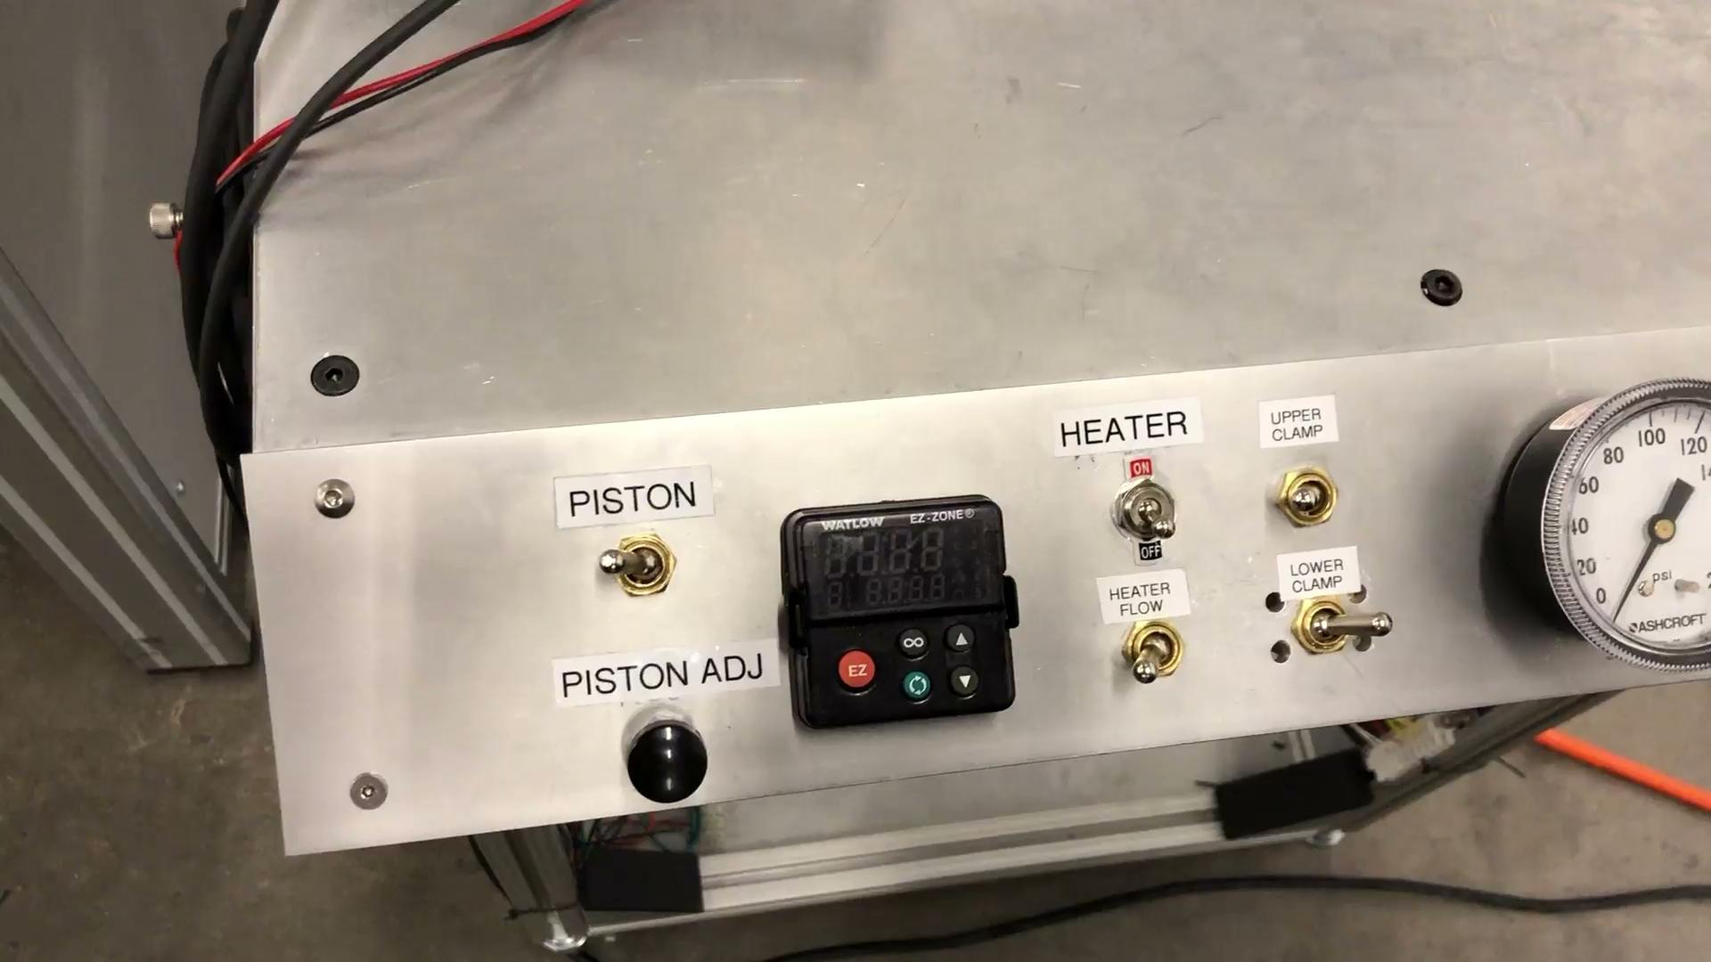
Demonstration - Pneumatic Cylinder and Digital Micrometer

Slide 13
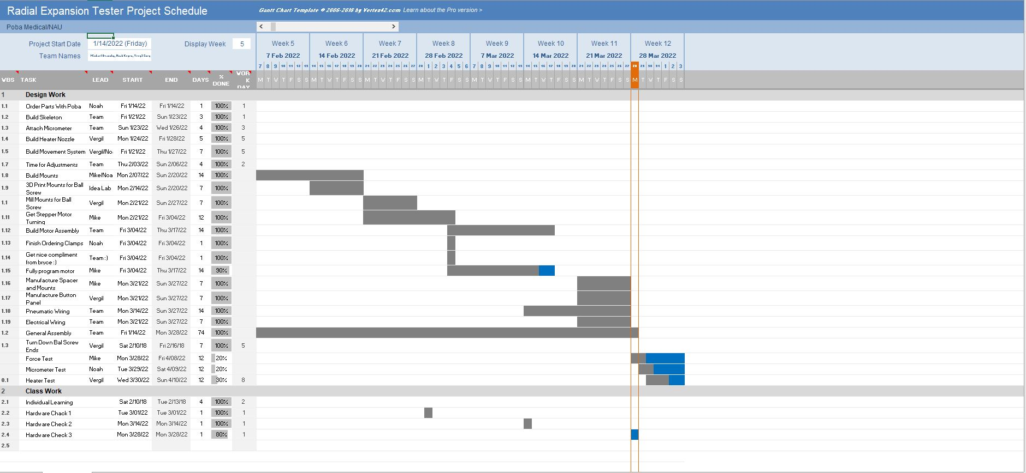
Gantt Chart

